Slide 1

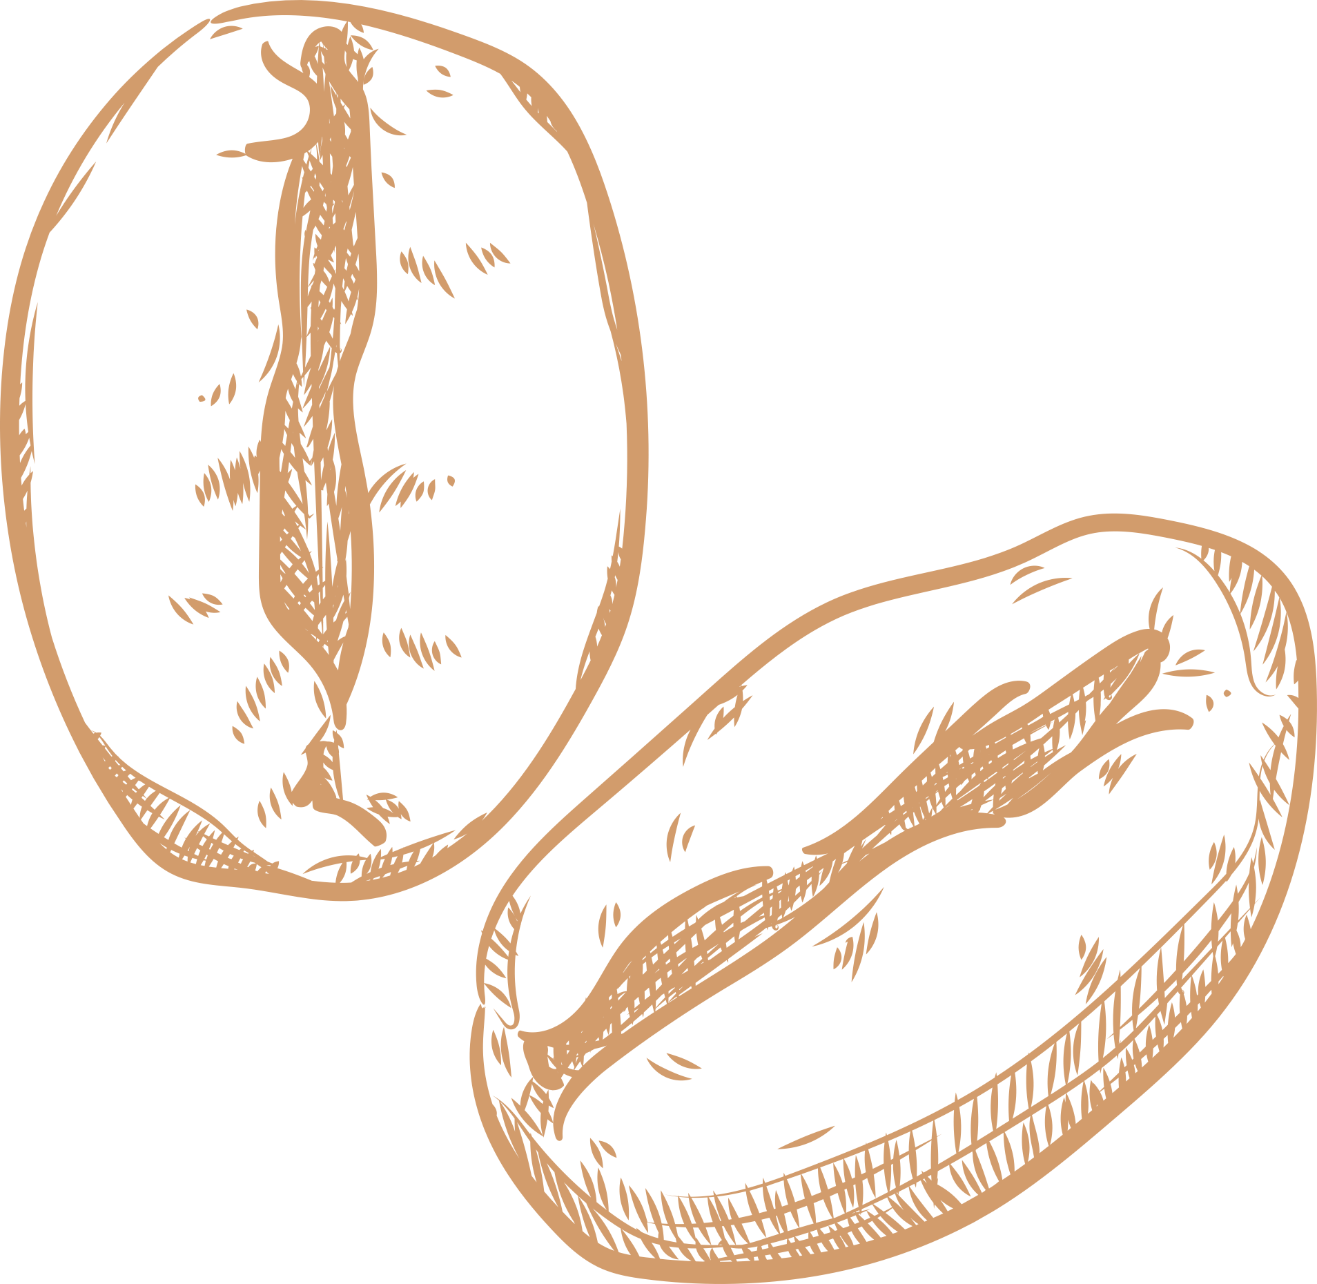


SO, HOW DO YOU LIKE *YOUR* COFFEE?
University of Western Australia
Data Analytics Bootcamp - 2023

Slide 2
HAVE YOU EVER WONDERED...
What is it about your favourite coffee that you enjoy?
Would you know how your preferences might translate into various coffee beans?
If you know you enjoy coffee from Colombia, does that mean you might enjoy coffee from Rwanda?

Slide 3
PROJECT DESCRIPTION
ANALYSTS
Jesslyn Lengkong, Dominique Spencer, Cayley Morrow
SCOPE
This project will create an interactive dashboard where users will select specific criteria using a numeric slider, to define and filter their personal preferences for a coffee bean. The dashboard will then generate the top 5 recommendations tailored to their slider, along with details that can be found on a bag of coffee including the roast level, country of origin, flavour notes, provenance and roaster name.
With the questions posed in the previous slide, the purpose of this project aims for users to become more in tune with their preferences and therefore (hopefully) increase their overall enjoyment of their daily ritual!
The dataset used was created by Tofer Kim, and made available through his coffee-recommender repository.
It contains 5,125 rows of data, scraped from a coffee review website, and includes cupping scores on variables such as coffee aroma, flavour, acidity, body and aftertaste.
The reviews date from February 1997 to January 2019.

Slide 4



SOURCES
https://www.kaggle.com/datasets/fatihb/coffee-quality-data-cqi
Inspiration for project.
NB - This dataset was not the one used in the final project.
https://www.coffeereview.com/
Website where coffee review data was scraped.
Scraping was done and a dataset was created by Tofer Kim, and can be found on GitHub in the repository coffee-recommender.
https://github.com/toferk/coffee-recommender/tree/master
Repository containing dataset used in this project.

Slide 5
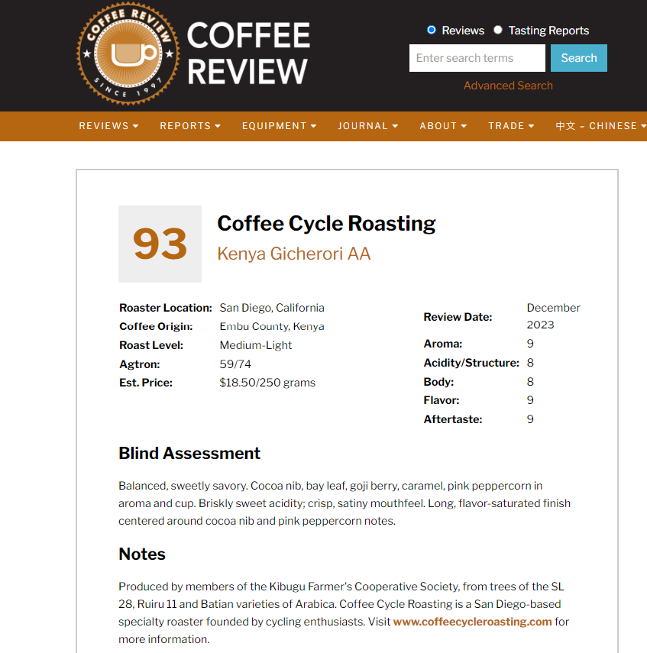

Slide 6
DEFINITIONS LIMITATIONS
01. ‘Cupping’ Score
01. Timeline
Rating = cupping score.
This is where coffee professionals test each coffee against the above variables, and an overall score is given to each coffee.
Coffee reviews date as far back as 1997, so recommendations (specifically the roaster) may not be completely accurate.
02. Rating (in dataset)
02. Sliders
The overall score each coffee achieves out of 100.
≥ 80 is deemed ‘specialty’ coffee.
< 80 is deemed ‘commodity’ coffee.
The sliders are fairly vague and could be more specific in terms of preferences!
03. Sliders
03. Coffee with milk
User taste preferences based on variables incl. coffee aroma, flavour, acidity, body and aftertaste, out of a score of 10. More info in the recommender app.
Our ratings are for black coffee only, as there weren’t sufficient data points for coffee containing milk.
04. Desc_1 & Desc_2
04. Missing data
Desc_1: Describing the coffee tasting notes.
Desc_2: Describing the coffee provenance.
Due to null values, we lost 2000+ rows of data.
However, the machine learning model won’t have worked if they remained within the file.

Slide 7
CODING APPROACH

Slide 8
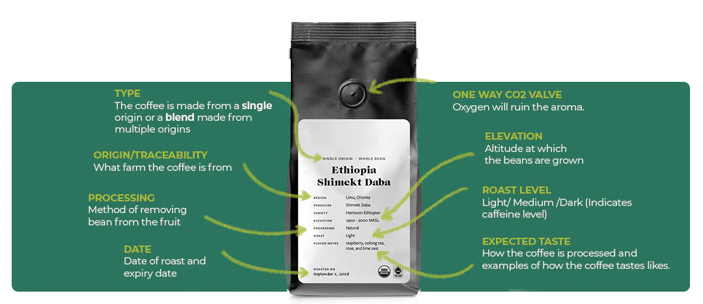
FOCUS...

Slide 9
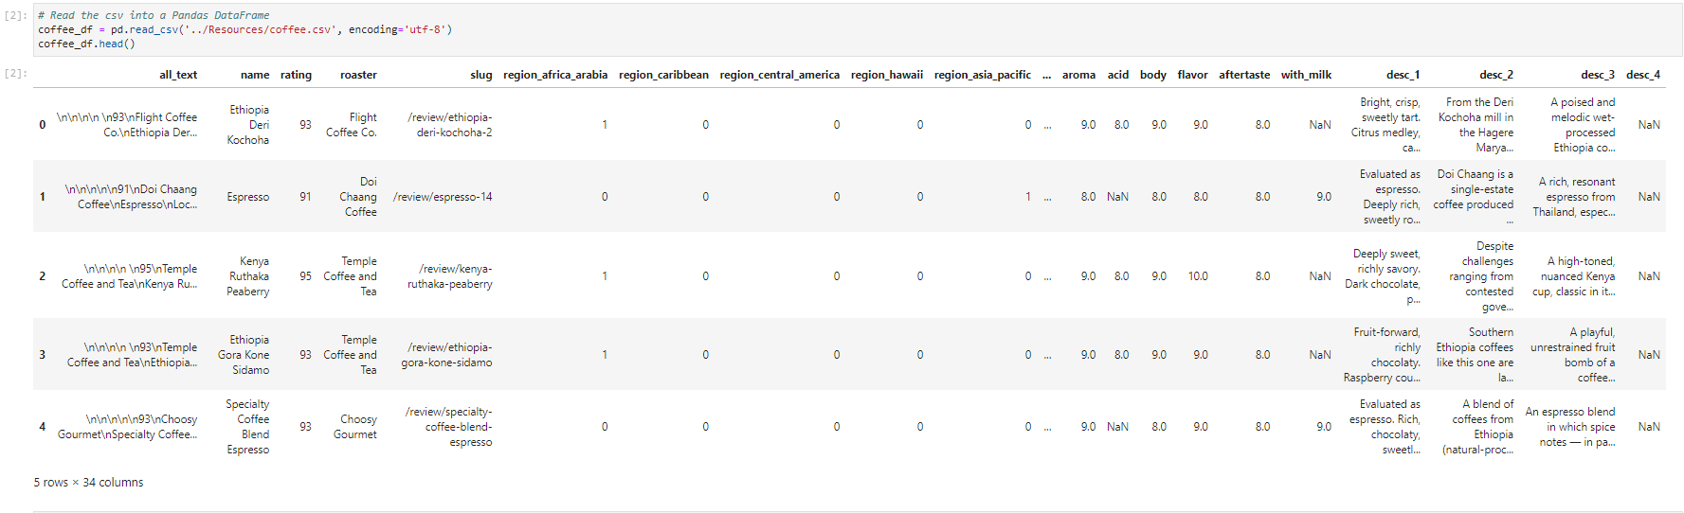
Initial csv file

Slide 10
Columns
slug
Unique identifier for each coffee blend.
name
We started with 34 columns,
and ended with 15 columns.
Name of the coffee blend
roaster
Coffee roaster responsible for the blend.
roast
Roast level of the coffee (e.g., light, medium, dark).
country_of_origin
Country where the coffee beans are sourced.
desc_1 and desc_2
Additional information about the coffee's origin.
rating
Rating of the coffee blend.
latitude and longitude
Coffee quality attributes rated by users.
aroma, acid, body, flavor and aftertaste
Coffee quality attributes rated by users.

Slide 11
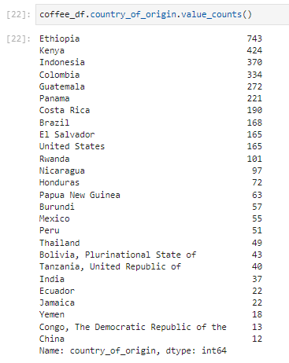
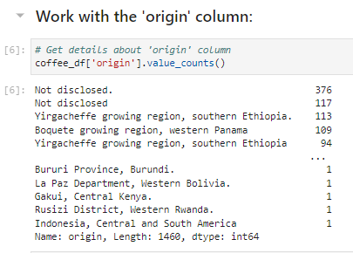
After
Before

Slide 12
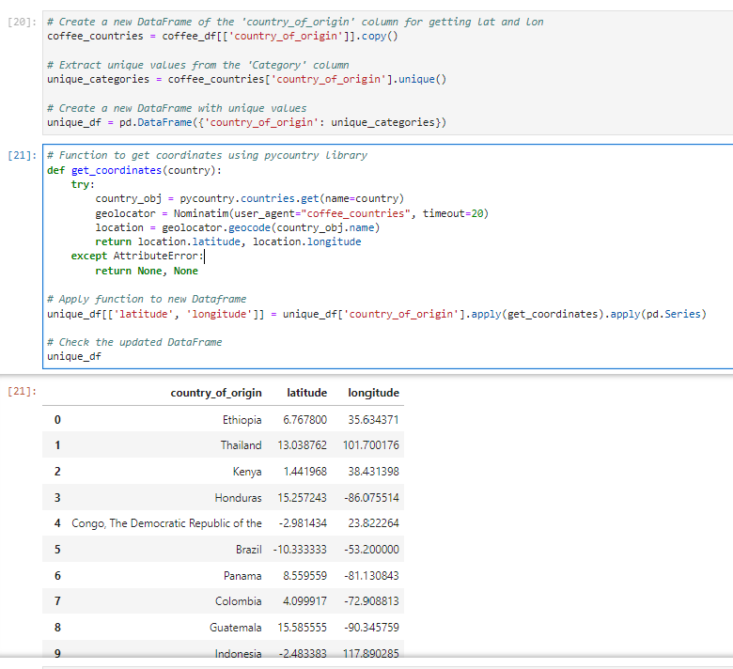
Get Latitude and Longitude coordinates for the dashboard map

Slide 13
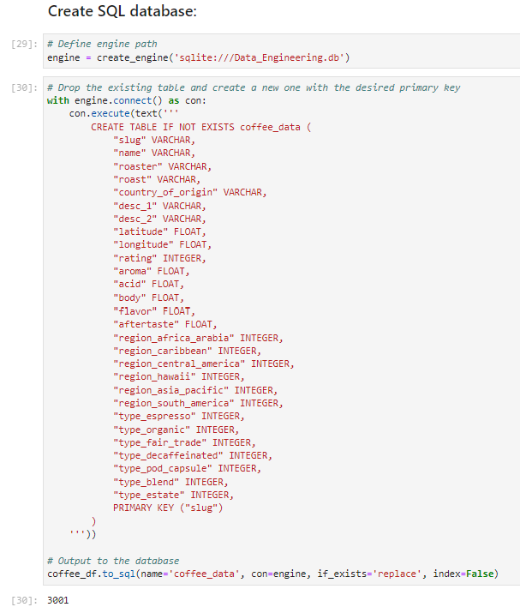

Create SQL database
We ended up with 3001 datapoints for our machine learning model

Slide 14
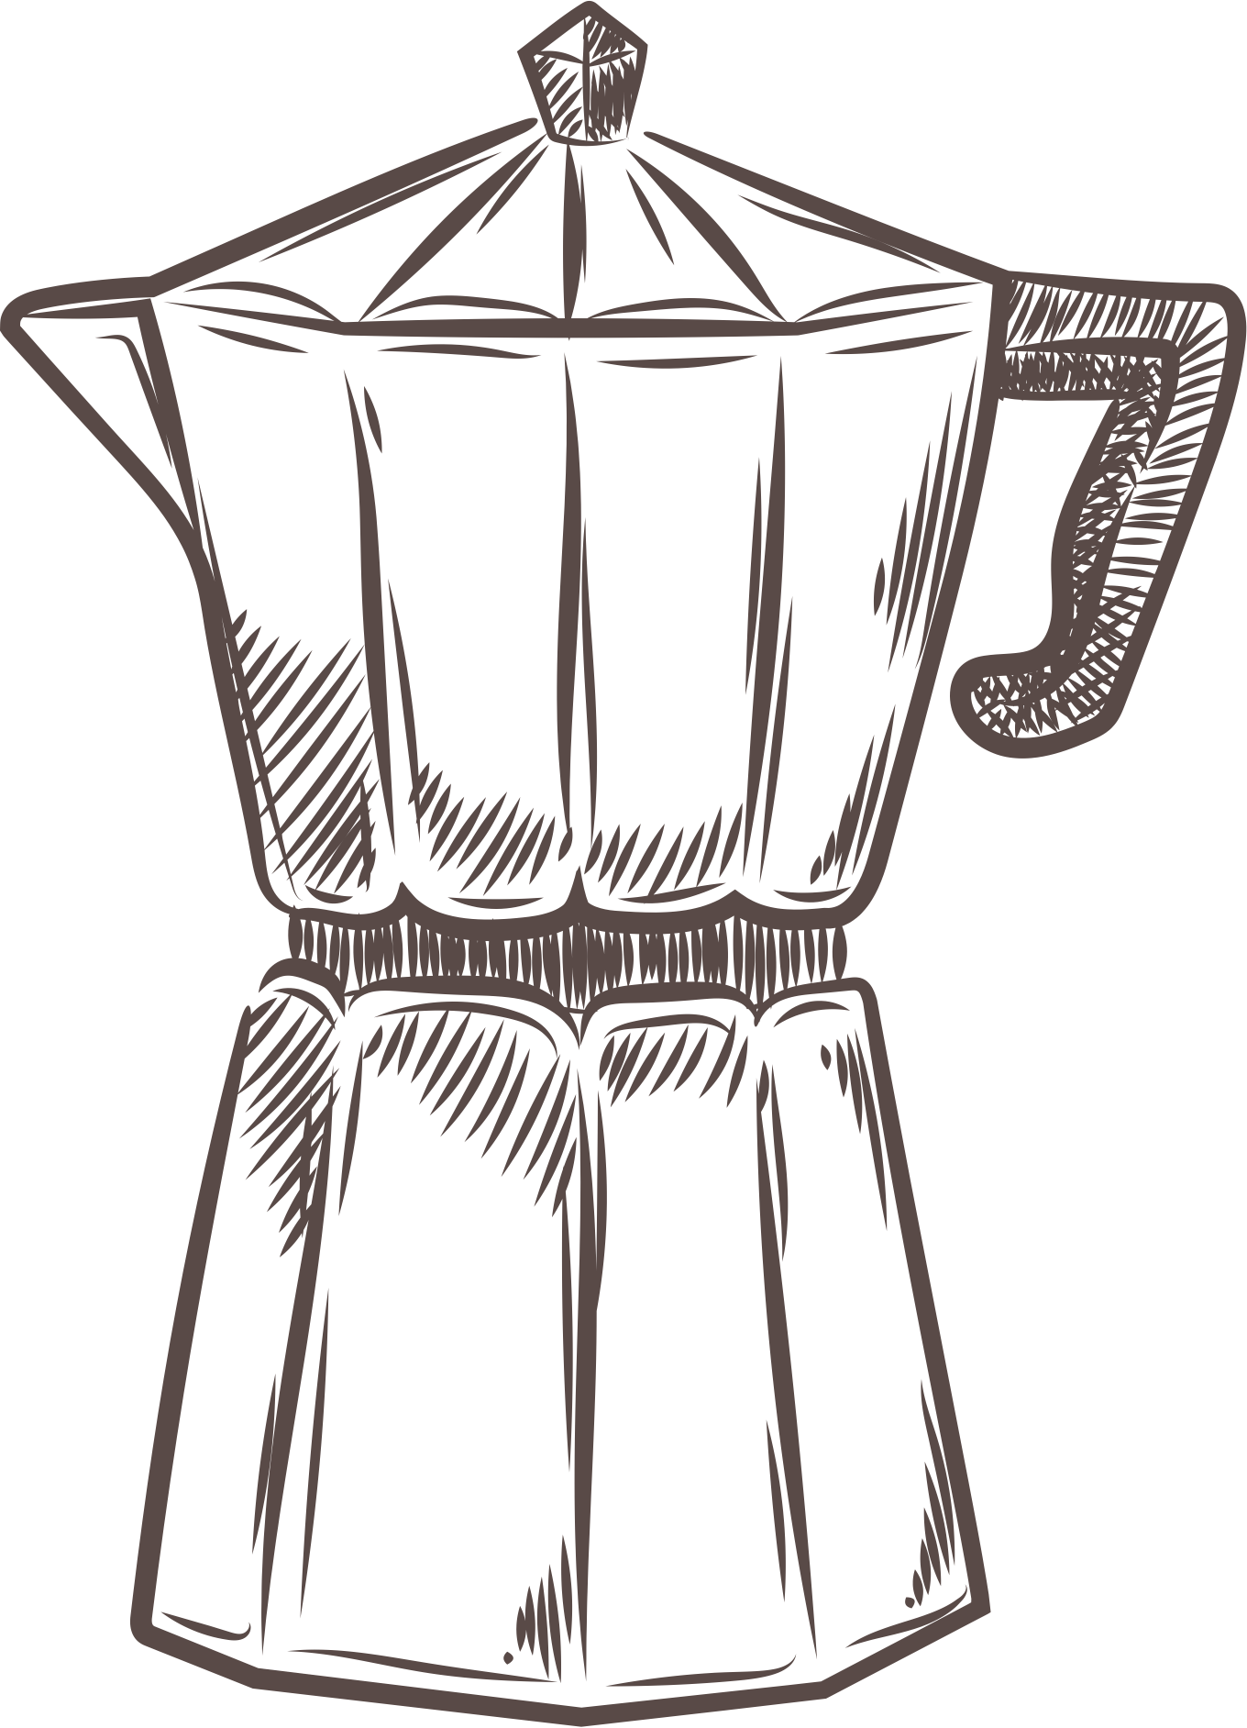
coffee.csv
Data_Cleaning.ipynb
config.toml
new_coffee.csv
streamlit
SQL Database
Flask
Dashboard
app.py
Machine Learning
scaler.joblib
ERD
pca_model.joblib
Notes:
showing the process we followed to create our dashboard

Slide 15
BUILDING THE RECOMMENDER

Slide 16
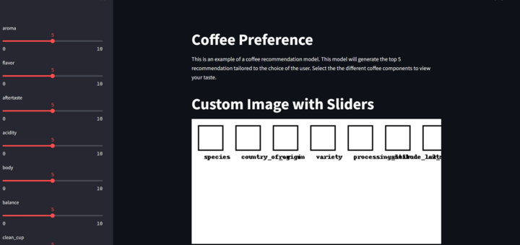
Original Setup
Notes:
After the data cleaning and confirming no Nan values we went on to plan the dashboard and the machine learning component. So here is the original set up of streamlit where we sketched up what we wanted.

Slide 17




Machine Learning
PCA application
Save & Incorporate Models
Specify Features
Standardise Data
Notes:
So to start with "machine learning" (in quotations because it isn't exactly the machine learning we learnt in class) we were able to identify that we wanted a recommendation system.
So we started with a journey with our machine learning and these were the steps we tried to implement.

Slide 18

Aroma
1
Acidity
2
Flavour
3
Features
(Rating 0-10)
Body
4
Aftertaste
5
Notes:
First we defined the features that we wanted to incorporate which were the coffee characteristics that you, I or someone say a barista would select. These include 5 features scaled from 0-10.

Slide 19
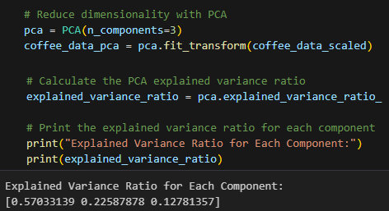
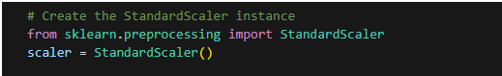
Standardise Data
PCA Application
Standardise Model
Notes:
Standardization was used to transforms all features onto the same scale.
This in turn also mean that we needed to load our scaler function into a model so that our user input would also be standardised
We also applied PCA to reduce the number of features and enhance the and reducing the origin set of variables. It also helped us visualise some of the factors and spot trends such as

Slide 20
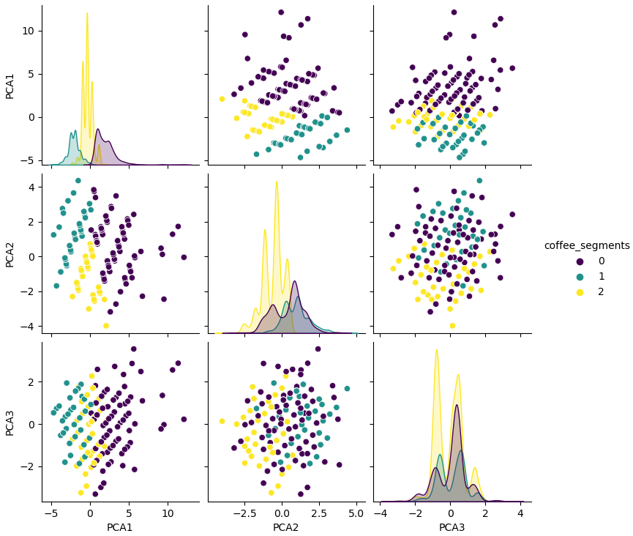

PCA Application
Explained Variance Ratio = 92.40%

Slide 21
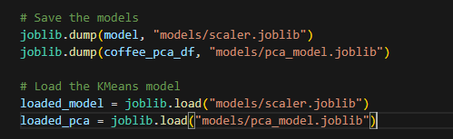

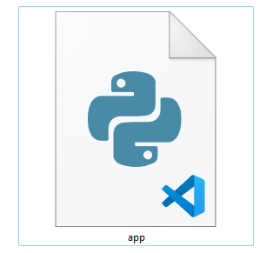
.ipynb
Save & Incorporate Models
Coffee Recommender app.py
Notes:
Next we used the joblib module to save the scaler and pca_models and implement it into the python file for the application.

Slide 22

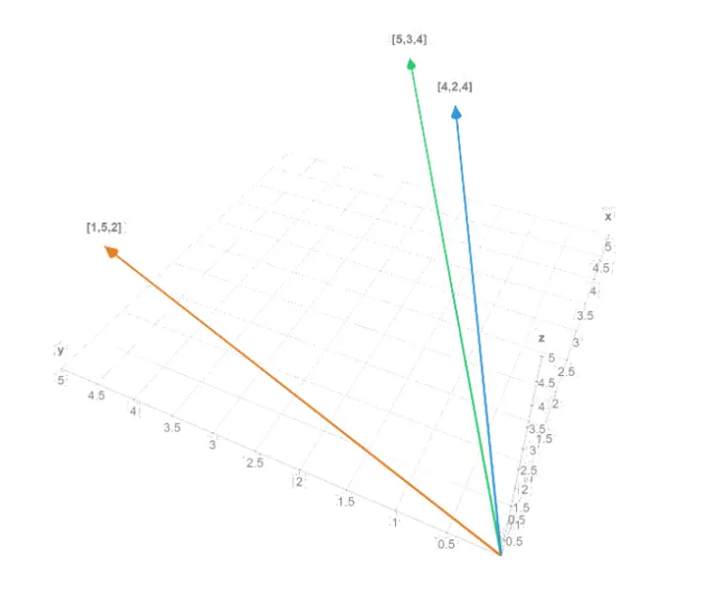
Cosine Similarity
What is it?
Metric that tells us how similar or different things are
Notes:
Now for the our recommender system, we noted that the normal machine learning systems were not going to fit what we wanted to achieve.
This is where we were recommended to use the Cosine Similarity.
Dom found a GREAT video if you guys love geeky videos made simple and if you don't mind weird intro songs.
Basically Cosine Similarity is a module and python library that uses mathematics to tell us how simlar of different things are, this includes numbers, features, text etc.

Slide 23
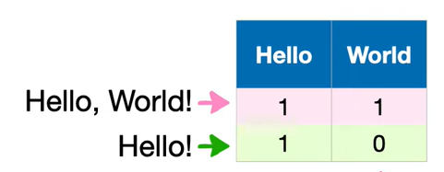
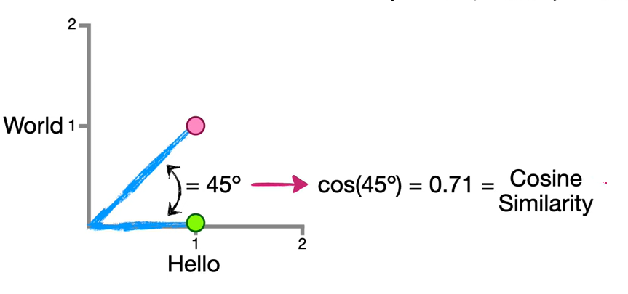
Cosine Similarity
How does it work?
Determines the angle between the two lines plotted on a graph and gives and output between
0 and 1
Notes:
I will try and explain it, and to tbh I only fully grasped the concept not too long ago so there were many things we would change.
But basically, the system with give a 0 or 1 for True or False for each components and create a dataframe
It will then place these "points" on 3D graph. The angle between the two are found using the cosine function and the higher the result the more similar the items are. This is a REALLY simply way of explaning it because BIG BRAIN so I can send the link to the geeky video for further clarification.

Slide 24
Original Setup

Slide 25
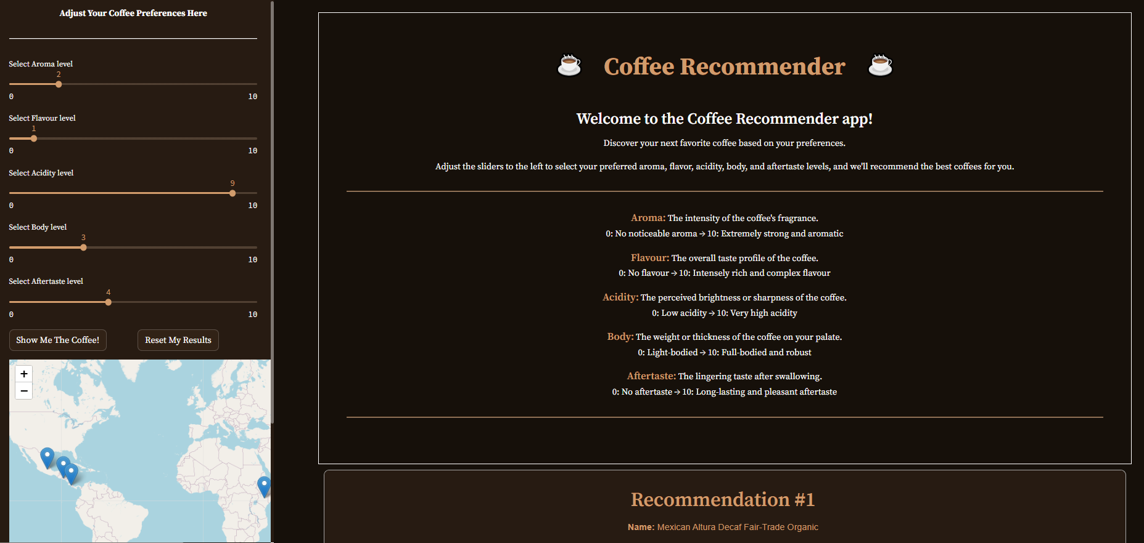
What We Developed
Notes:
From the original concept this was what we managed to come up with

Slide 26
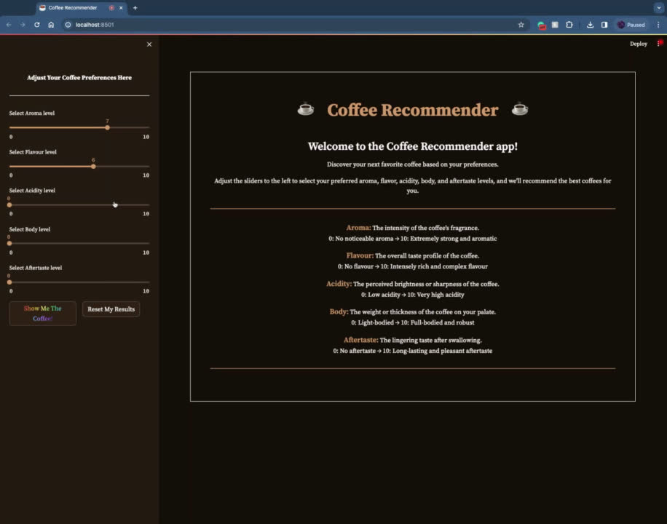
Video Recording

Slide 27
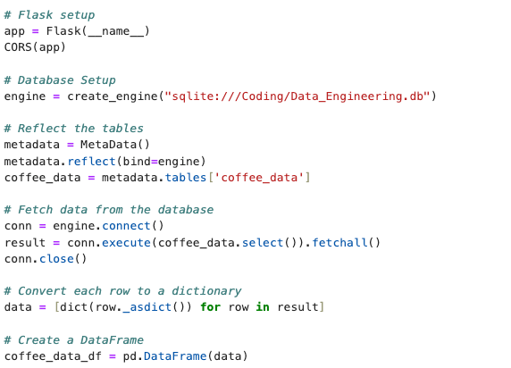
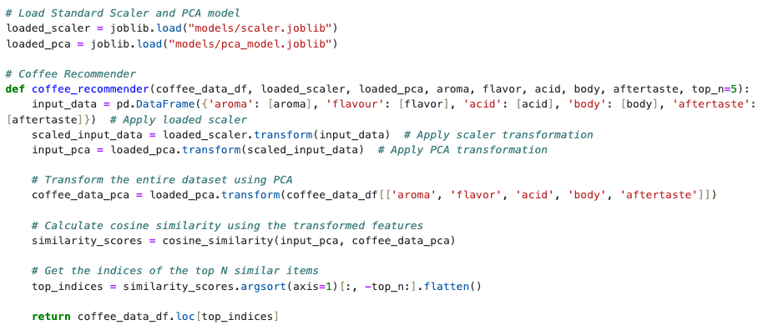
SETTING UP A DASHBOARD
Notes:
created a connection to the SQL database we created when cleaning our data and converted it to a df for easy reading for the recommender model
we loaded the pca and scaler into the model to transform the dataset to help populate recommendations based on pre-determine criteria

Slide 28
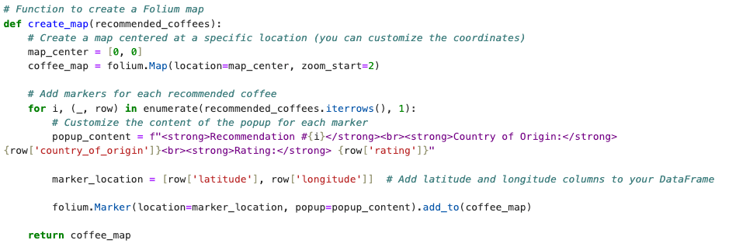
USING STREAMLIT TO CREATE A DASHBOARD
Notes:
we wanted to incorporate a map element using our lat and long data with our recommendations to have a visual representation of where your coffee has come from

Slide 29
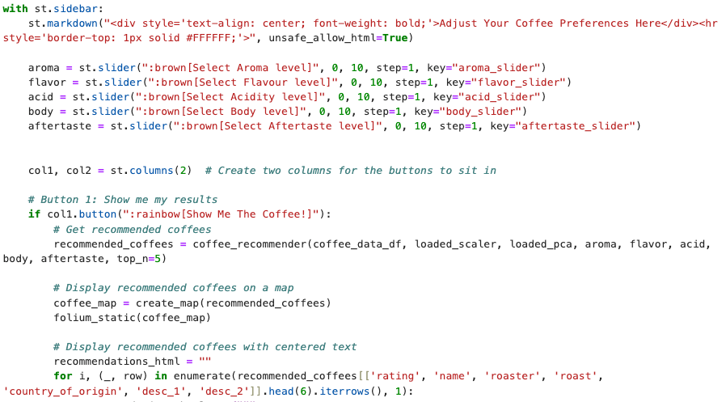
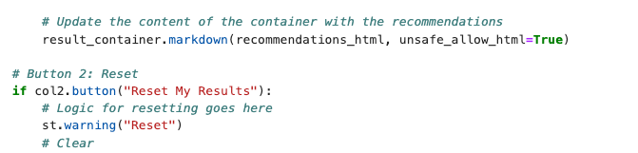
USING STREAMLIT TO CREATE A DASHBOARD
Notes:
I then defined the sliders and created two buttons one to initiate the display and one to reset the model to change the populated recommendations

Slide 30
Demonstration

Slide 31
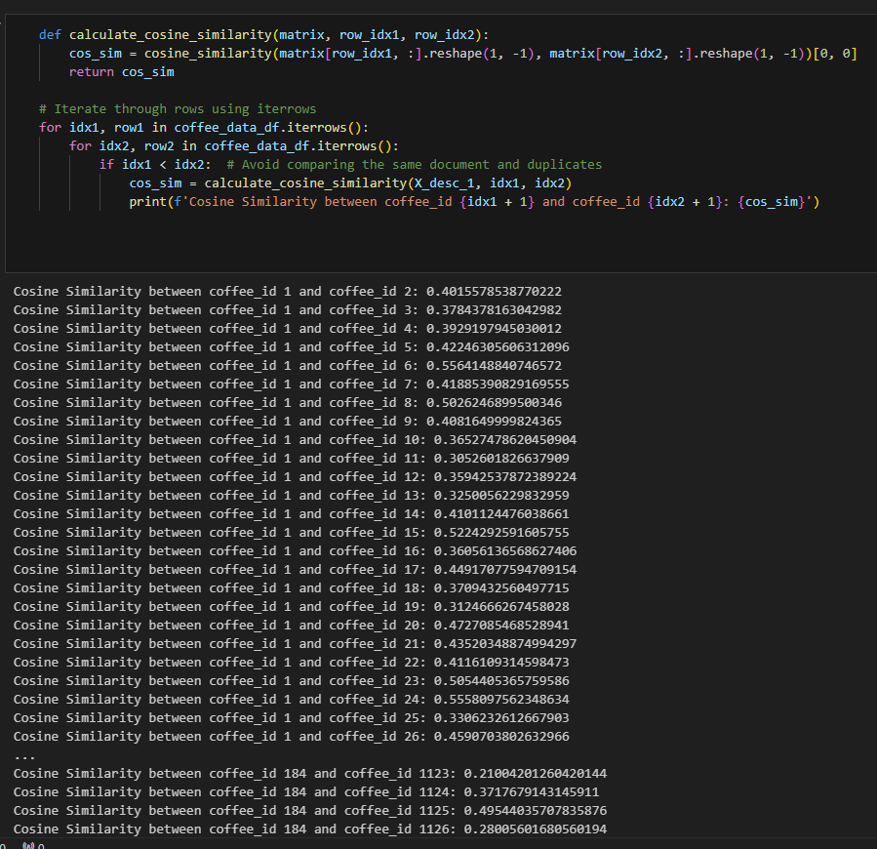
Final Thoughts
Application of Vectoriation
Use one-hot encoding to define roasts implementation
Allow for user review after recommendation given
Web Scraping application for real-time output
Show the cosine similarity values in dashboard
Incorporate model into a mobile app for easier user
Notes:
there are some limitations to our machine learning model
- first technically it's not "machine learning" but has components of machine learning
Further time and understanding would mean we could also use Vectors to work with the coffee descriptions and then use the cosine similarities.
- We also attempted to use one-hot encoding but were unable to use this due to time issues.
In an ideal world you could turn this into a mobile app that would be easier to use (in terms of convenience)

Slide 32
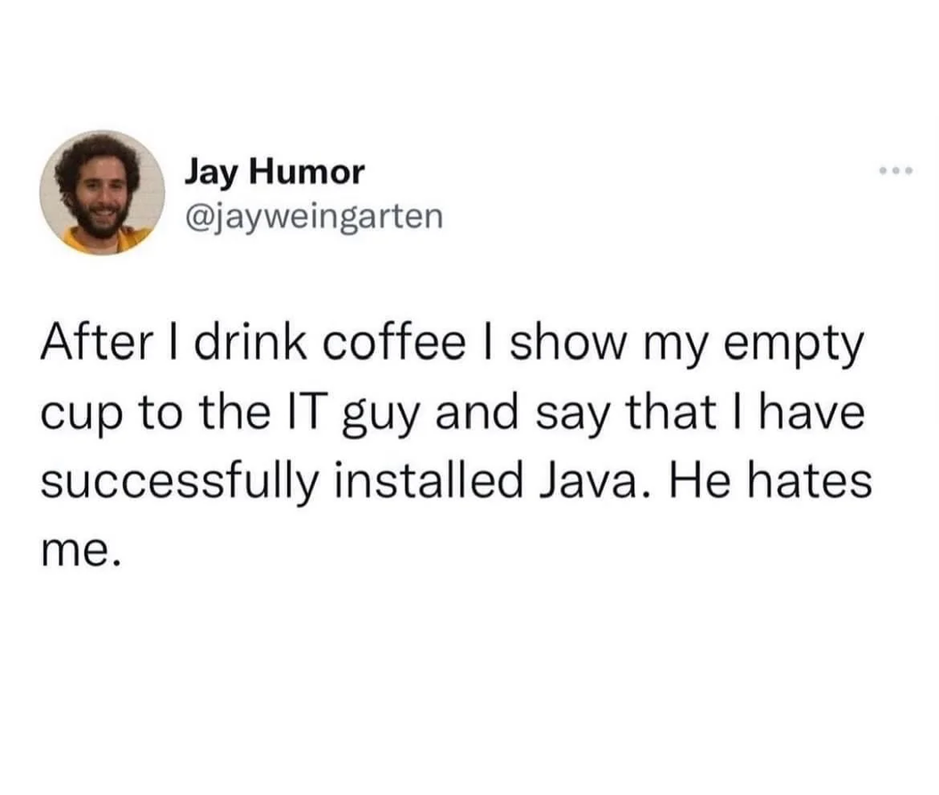
Notes:
We just thought we add in a little joke to finish off our presentation

Slide 33
THANK YOU

